Slide 1
Zomato Data Analysis
Team Members
Project Guide
Viha Dave & Purvesh Kachhiya
Date: 13th March 2023
Bhagyesh Bhut
Akshat Patel
Yash Shah
Dharam Rajvadiya
Riya Anadani

Slide 2

Agenda
Problem Statement​
Resource-Requirement and Specification​
​Solution Approach​
Services and Tools to be used​
Architecture​
Workflow ​
Results​
Conclusion​
Future Scope​
References​

Slide 3
Problem Statement​
We need to analyze a dataset from Zomato in order to create some insightful findings that will improve convenience and consumer happiness. The business operations for the expansion of Zomato as an organization and the restaurants as people will also benefit from this procedure.

Slide 4
Resource-Requirement and Specifications​​
Resource​
There are CSV files of Restaurant information with All Required Details
Requirements​
Azure Portal Access
1. Resource Group
2. Azure Data Factory
3. Storage Account(Blob/ADLSgen2)​
4. Logic Apps
5. Azure Key Vault
Snowflake
Power BI
Azure DevOps

Slide 5
​​ Role Allocation ​
Azure Data Factory & DevOps : AKSHAT PATEL & YASH SHAH (Supporting role)
Snowflake & Snowpark : BHAGYESH BHUT & DHARAM RAJVADIYA (Supporting role)
Power BI : YASH SHAH, RIYA ANADANI & DHARAM RAJVADIYA

Slide 6
Solution Approach

Slide 7
Services and Tools to be used​
Azure DevOps
Azure Storage Account
Azure Data Lake Gen-2
Blob Storage
Azure Data Factory
Get Metadata Activity
Lookup Activity
For each Activity
Set variable Activity
Copy data Activity
Script Activity
Web Activity
Linked Service
Snowflake
Snowpark
Tables and schemas
views
Power BI

Slide 8
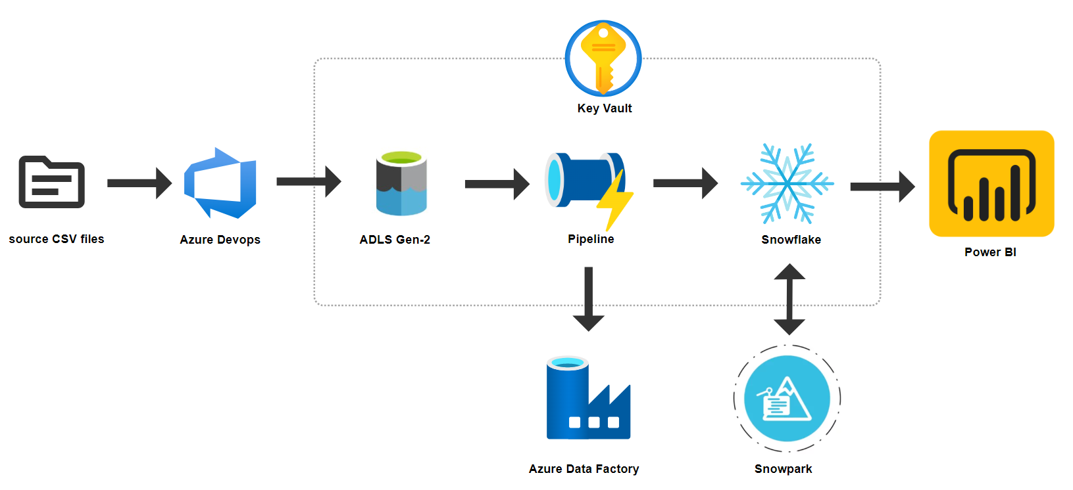
High Level Architecture

Slide 9
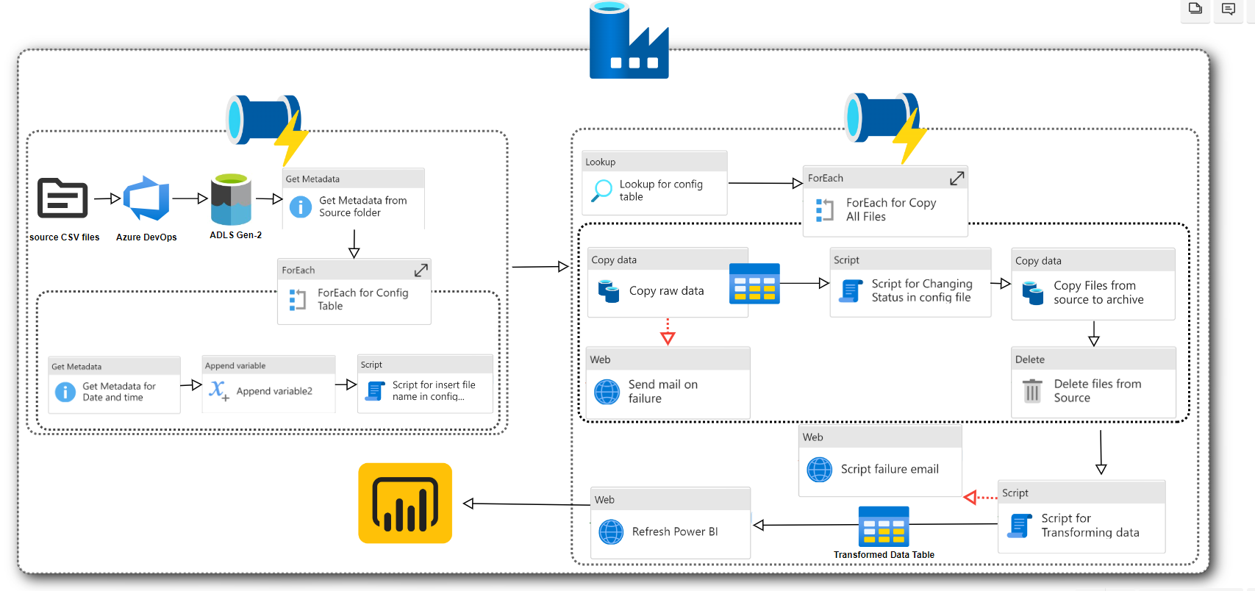
Workflow

Slide 10
Solution

Slide 11
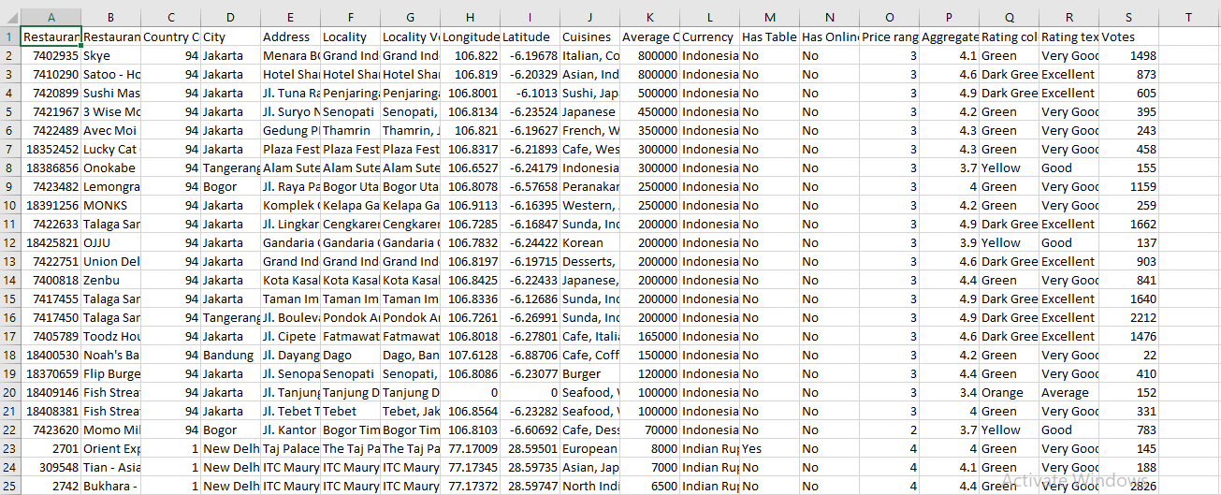
Zomato Raw Data Table

Slide 12
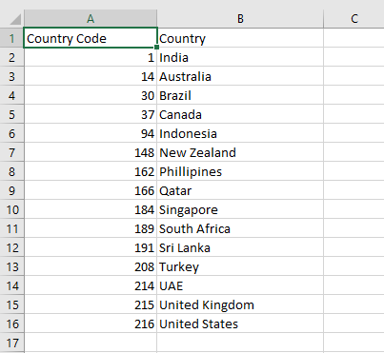
Country-code Raw Data Table

Slide 13
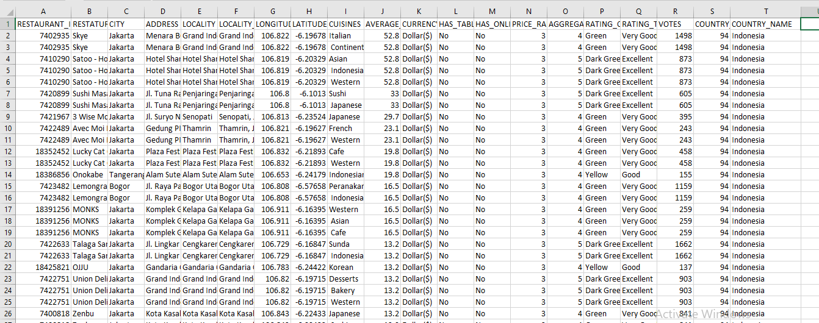
Transformed Data Table

Slide 14
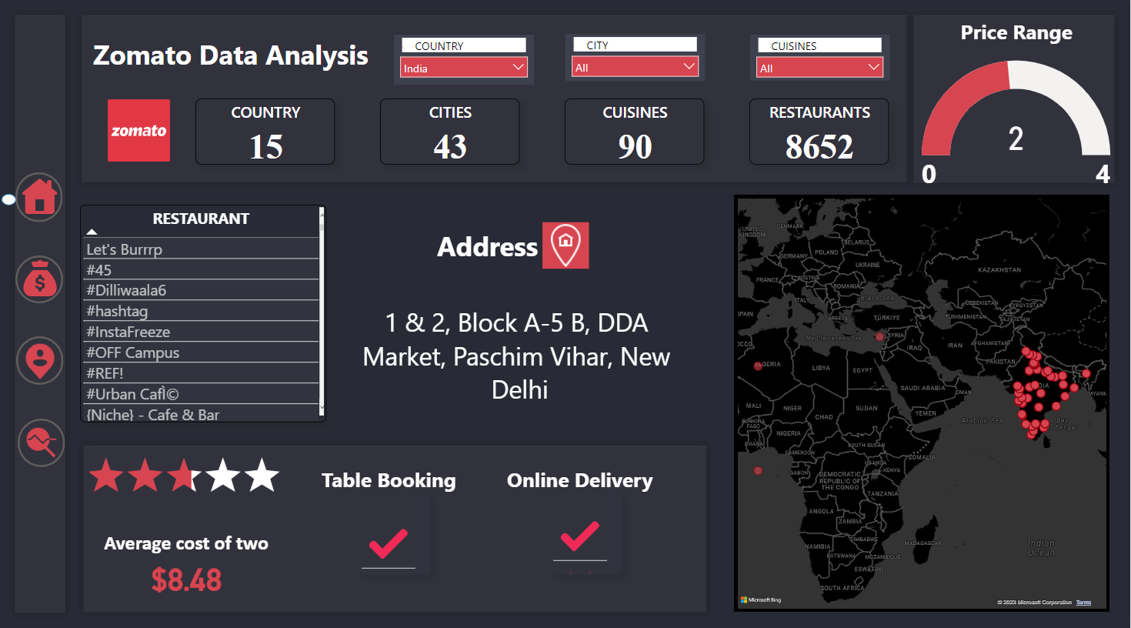
Power BI Dashboard

Slide 15
​​ Future Scope ​
Currency conversion from static to dynamic: Now, we are using the constant value of the dollar; however, we will design a method where the price fluctuates on a regular basis.
Real-time nationwide currency conversion: For the user's ideology, real-time price updates in any currency.

Slide 16
​​ Conclusion​ ​
We can conclude that the whole orchestration process gets automated once all the resources are in place and then there is no need of any supervision or Manual inputs unless and until any unexpected error occurs.
With the help of Power BI, we can easily gain useful insights for given Zomato Data​

Slide 17
​​ ​​ References​​ ​ ​
https://learn.microsoft.com/en-us/azure/data-factory/
https://docs.snowflake.com/ /​
https://docs.snowflake.com/en/developer-guide/snowpark/index
https://learn.microsoft.com/en-us/power-bi/

Slide 18





www.anblicks.com
Your Mail
Technology Partnerships

